Slide 1


Slide 2


Slide 3



Slide 4




Slide 5
Interpreter
Immediately
runs
Not efficient;
can run slow

Slide 6
Interpreter
Compiler
Immediately
runs
Not efficient;
can run slow
Delay before running
Runs efficiently

Slide 7
Interpreter
Compiler
Just-in-time
Immediately
runs
Not efficient;
can run slow
Delay before running
Runs efficiently
Immediately
runs
Runs quite efficiently

Slide 8

Interpreter
Compiler
Just-in-time
Immediately
runs
Not efficient;
can run slow
Delay before running
Runs efficiently
Immediately
runs
Runs quite efficiently
WebAssembly
Immediately
runs highly efficiently

Slide 9
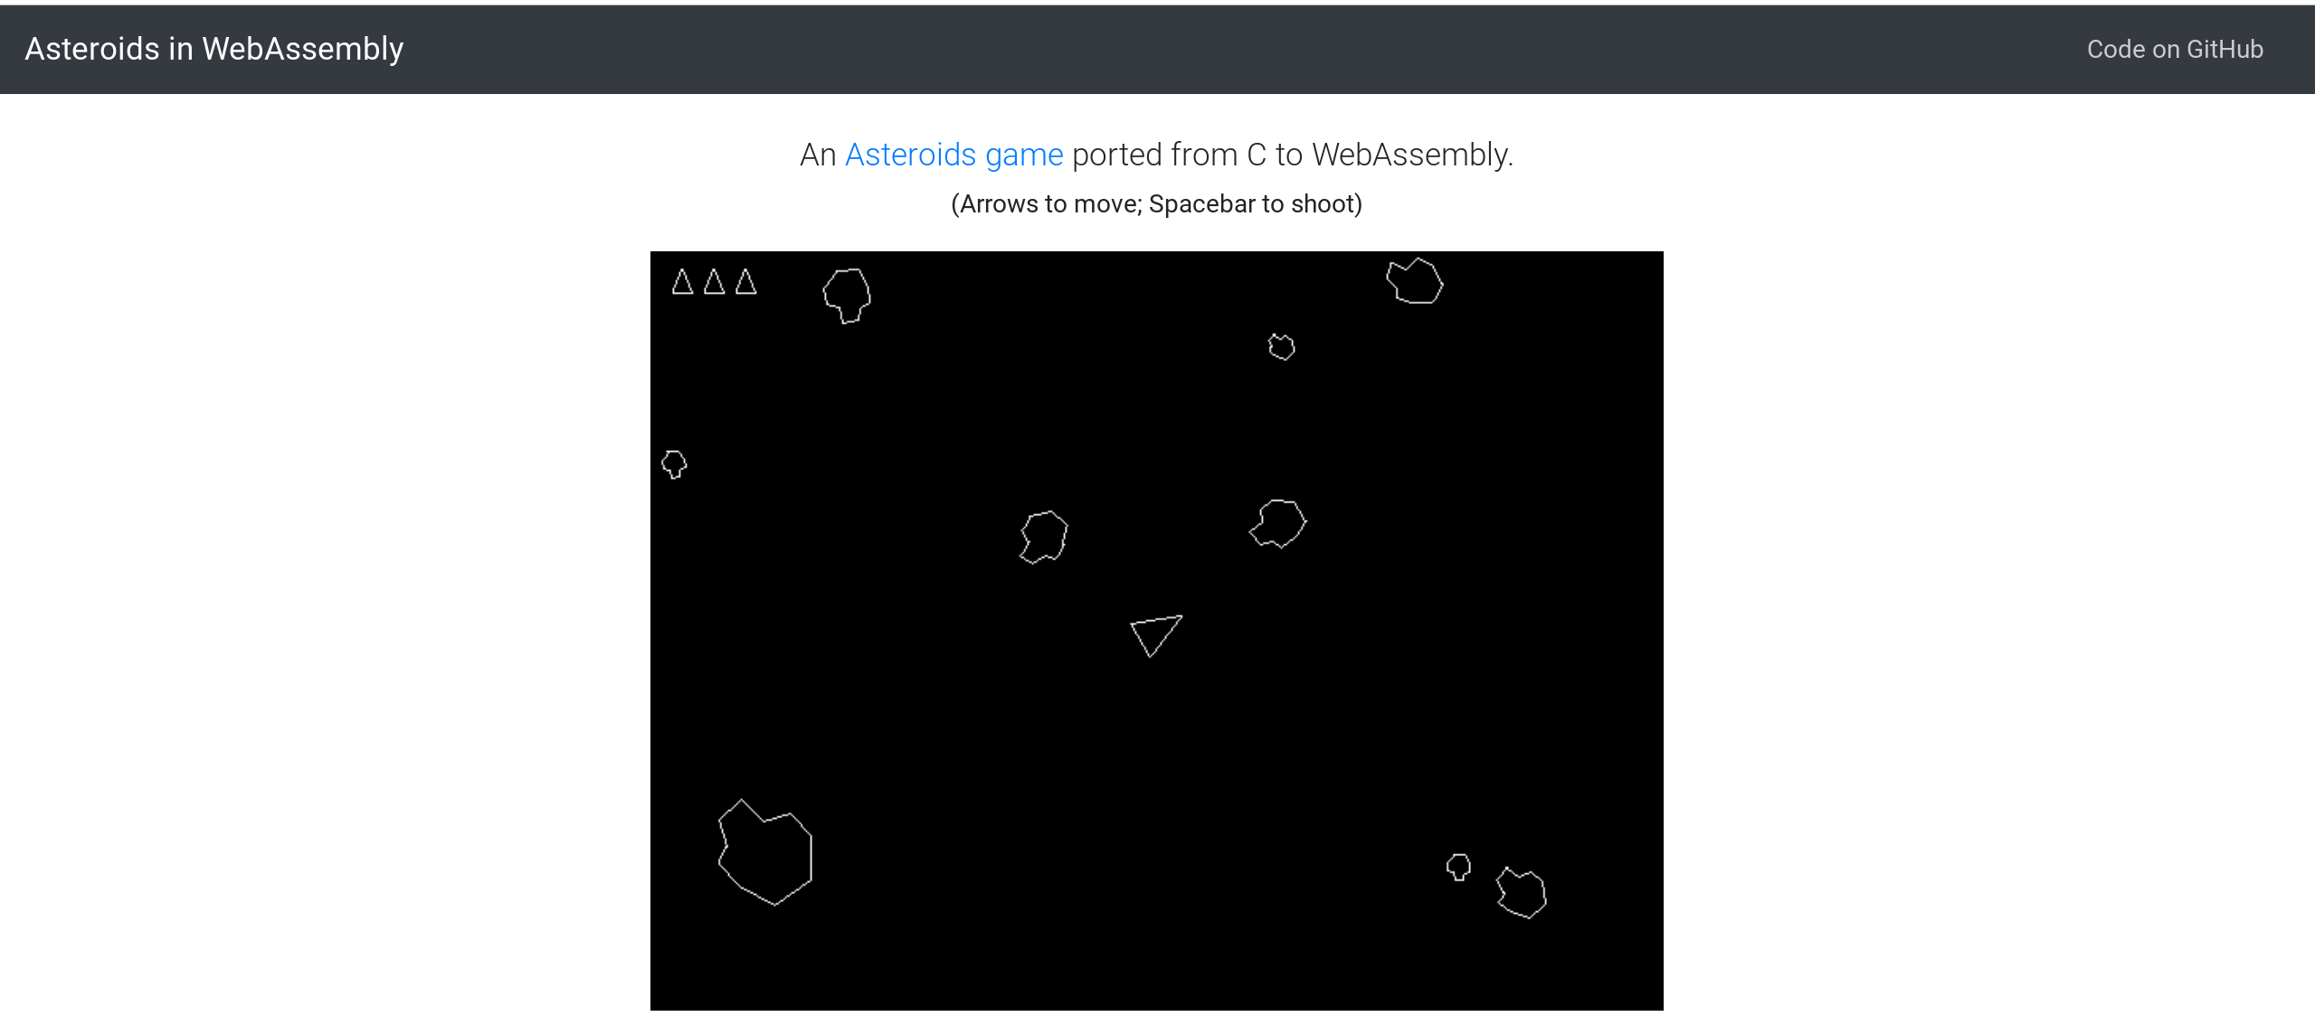
What is WebAssembly ?
levelupwasm.com/apps/asteroids

Slide 10
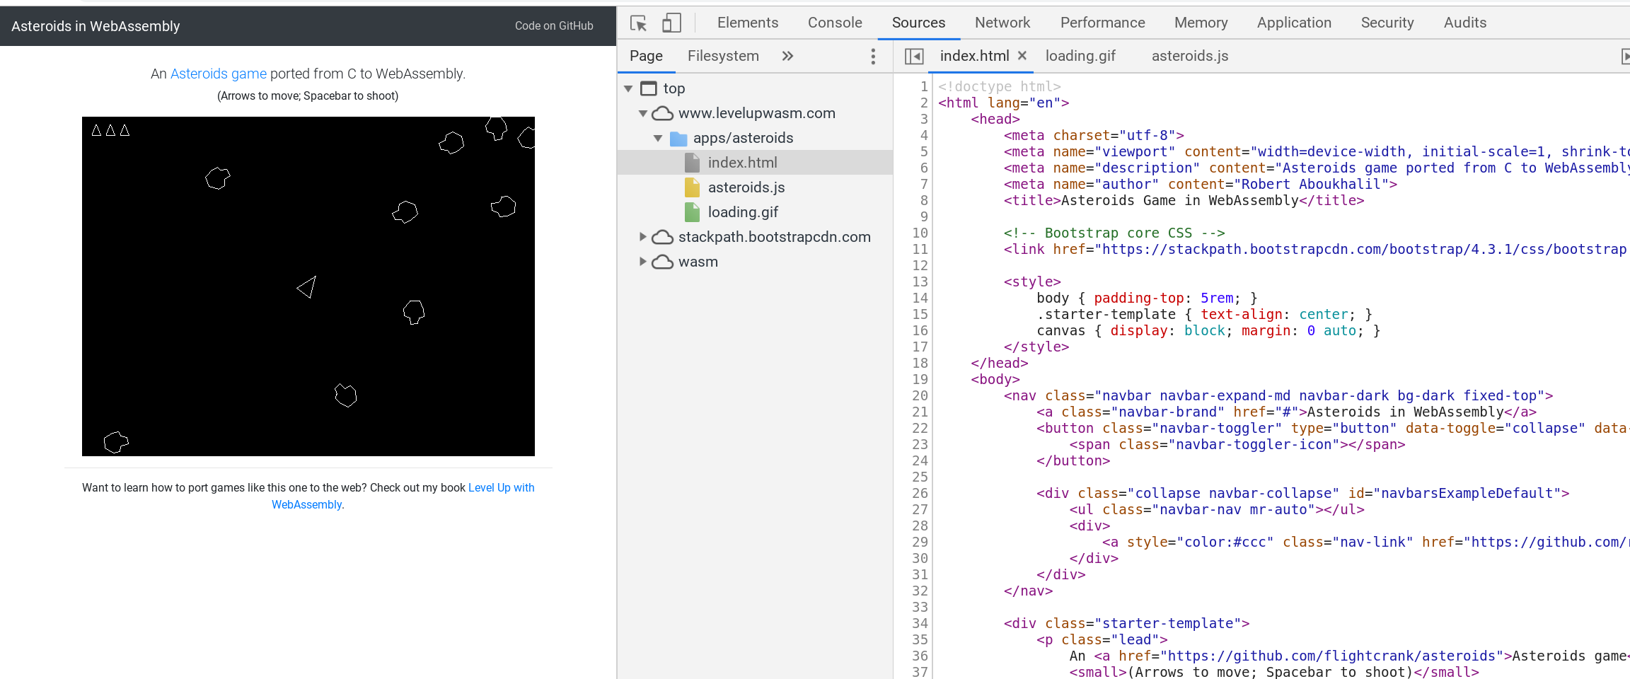
What is WebAssembly ?

Slide 11
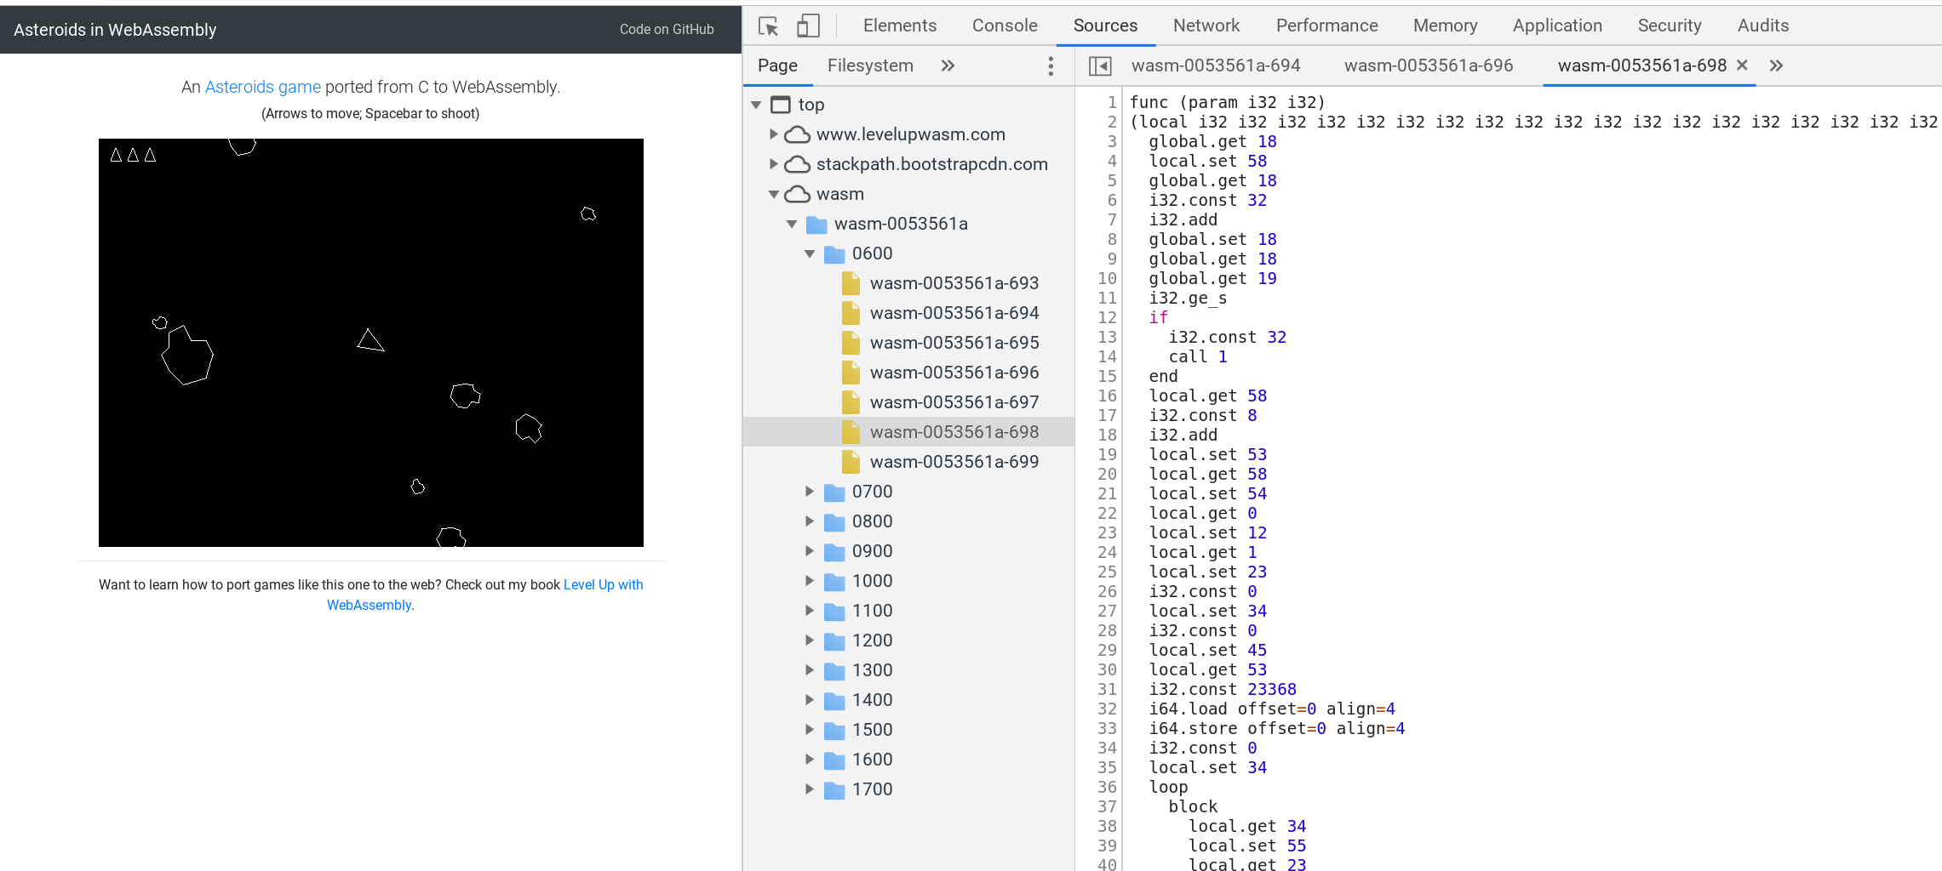
What is WebAssembly ?
WebAssembly code
(also called Wasam)
transpiled (converted) from C to WebAssembly to run directly in the browser

Slide 12
Why is it important?

Slide 13

Why is it important?
Speed

Slide 14
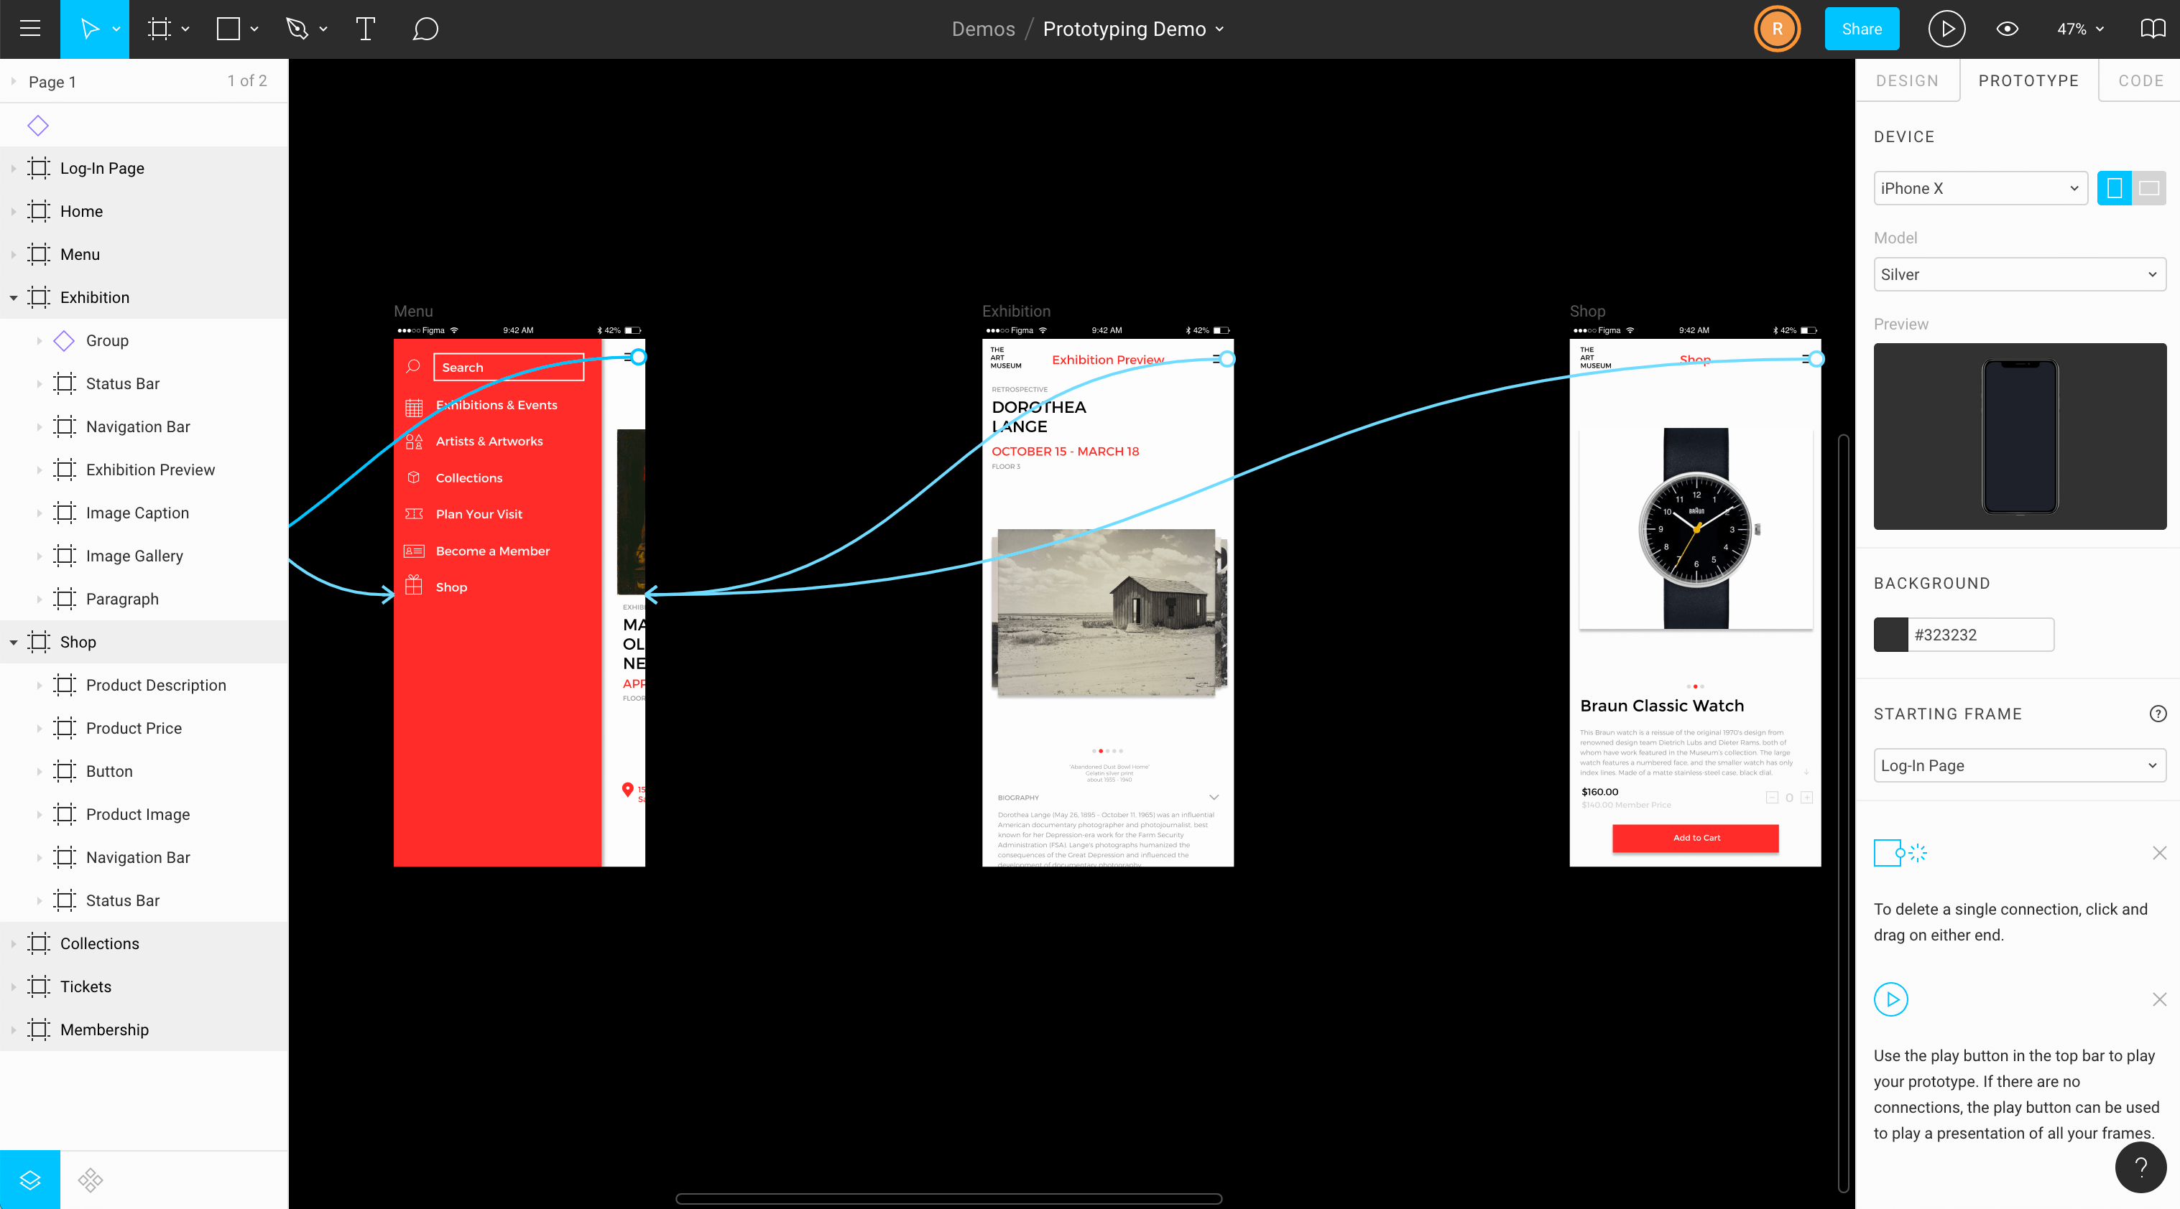
Why is it important?
Speed
Figma 3X faster

Slide 15
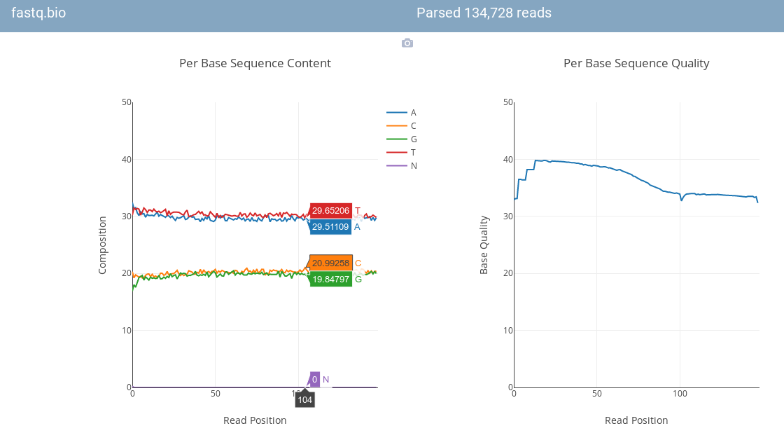
Why is it important?
Speed
fastq.bio DNA sequencer 20X faster
Figma 3X faster

Slide 16

Why is it important?
Run established code

Slide 17
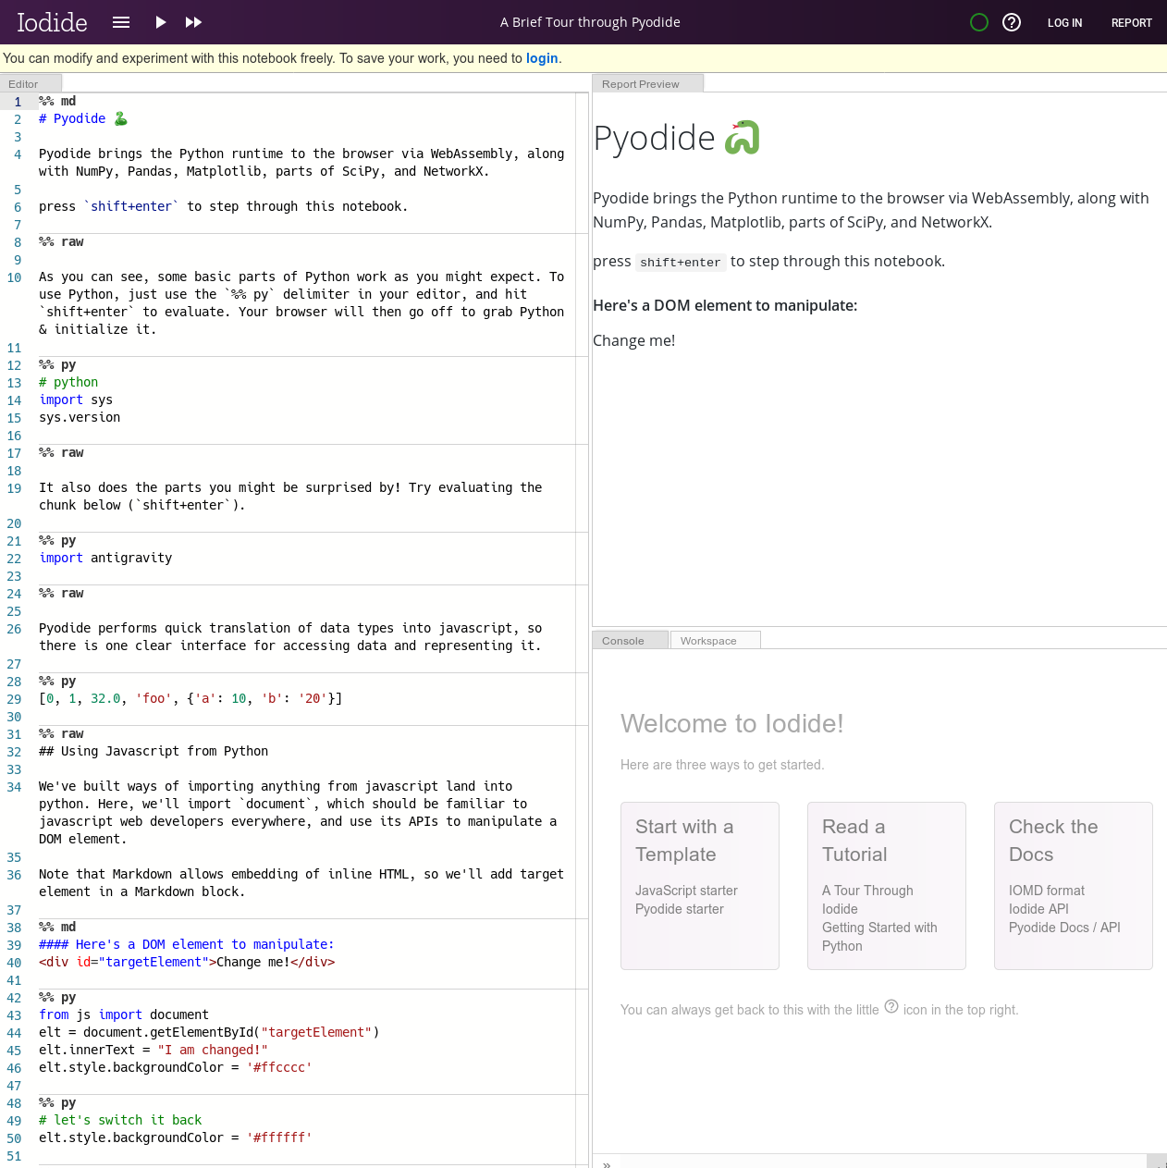
Why is it important?
Run established code
Pyodide: Python scientific on the browser

Slide 18
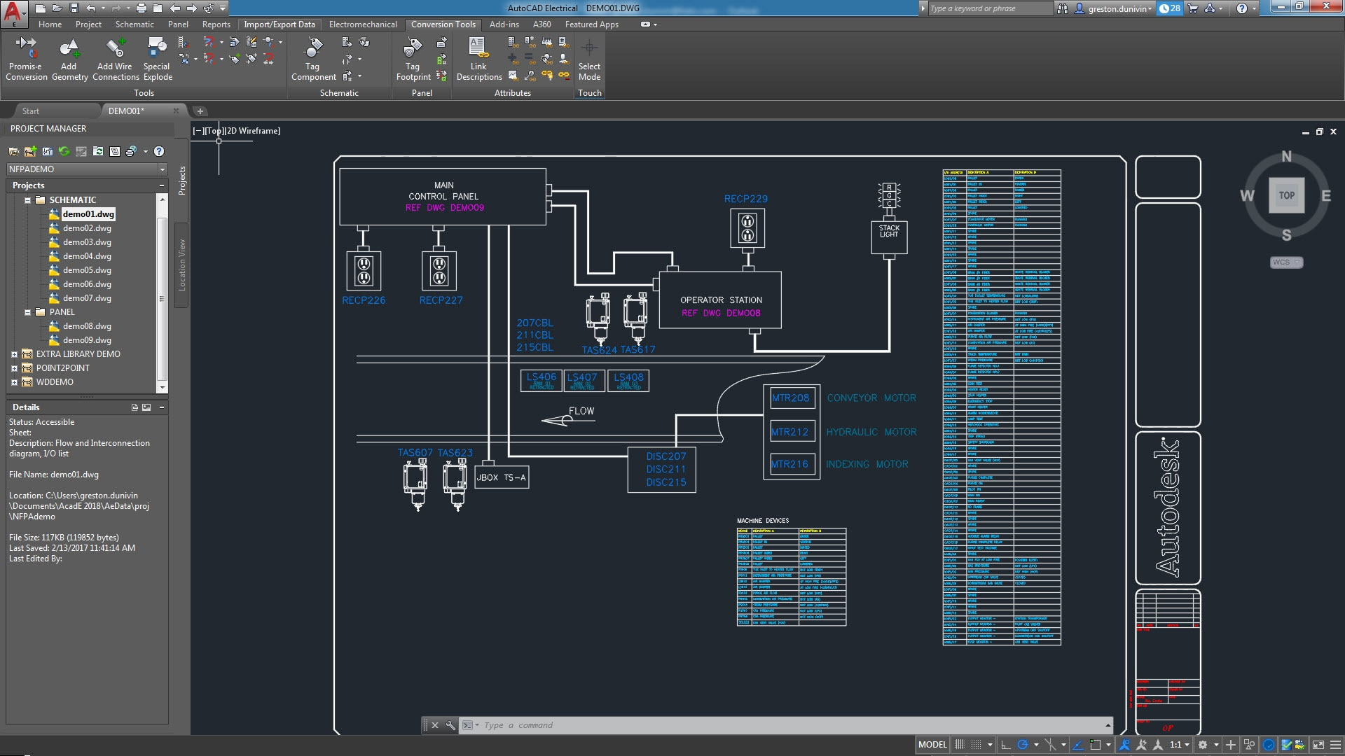

Why is it important?
Run established code
Pyodide: Python scientific on the browser
AutoCAD: web uses identical codebase as desktop

Slide 19
TL;DR
WebAssembly Code is ‘shipped in’ via a binary blob
faster & efficient execution
Run established code not written in JavaScript

